Slide 1
Fuga vs. LES

Slide 2
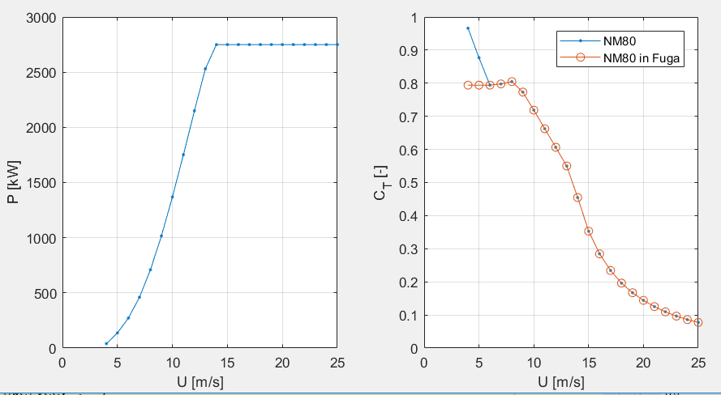
Input parameters
WT: NM80 (CT curve slightly changed for low wind speeds because of errors in Fuga)
R = 40m
Hhub = 170m (to minimize shear, putting it even higher gave errors when calculating the LUTs)
LES input
No shear
No veer
TI = 3,5%
U0 = 14m/s
“floating wind turbine rotor”: no hub height

Slide 3
Input parameters
 | Neutral | Stable | Unstable
Z0 [m] | 1 e-4 | 1 e-4 | 1 e-4
L [m] | Inf | 50 | -50
Zeta0 | 0 | 2 e-6 | -2 e-6
Zi [m] | 361,28 (close to 360) | 361,28 (close to 360) | 361,28 (close to 360)
zLo [m] | 4,01 (close to 4) | 4,01 (close to 4) | 4,01 (close to 4)
zHi [m] | 361,28 (close to 350) | 361,28 (close to 350) | 361,28 (close to 350)
Fuga scripting:
CASE z0 zi zLo zHi Zeta0

Slide 4
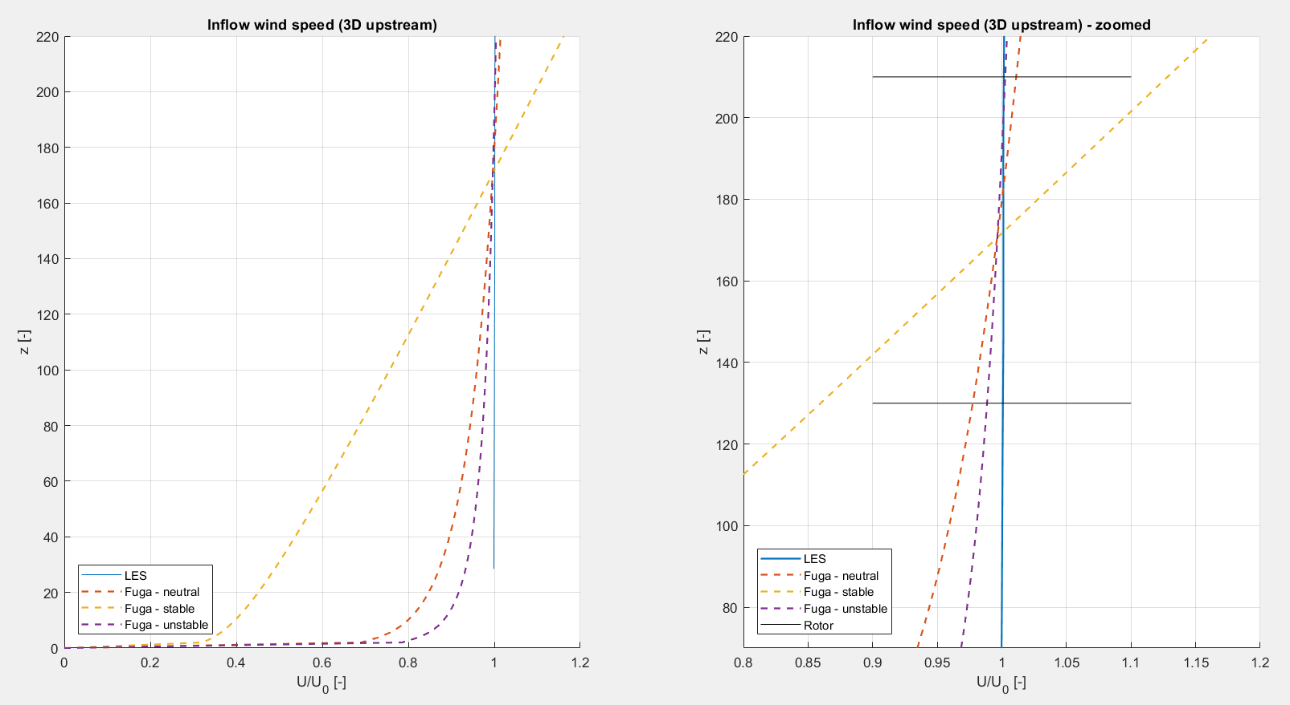
Inflow profiles

Slide 5
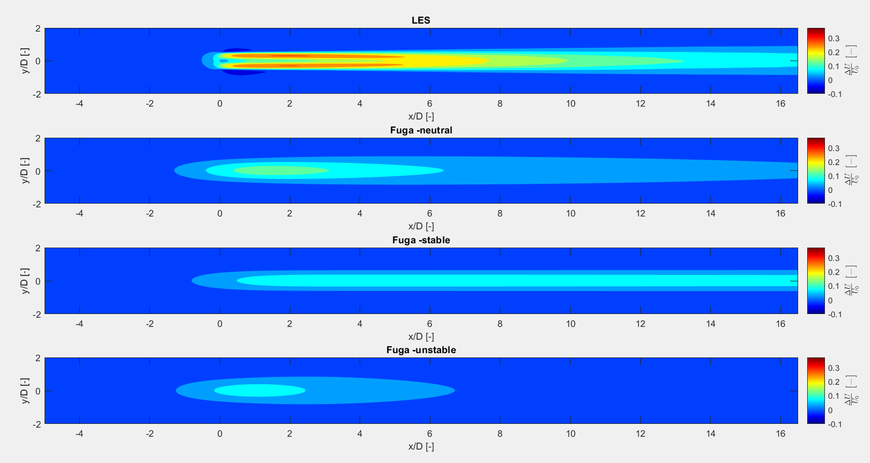
Single wind turbine

Slide 6
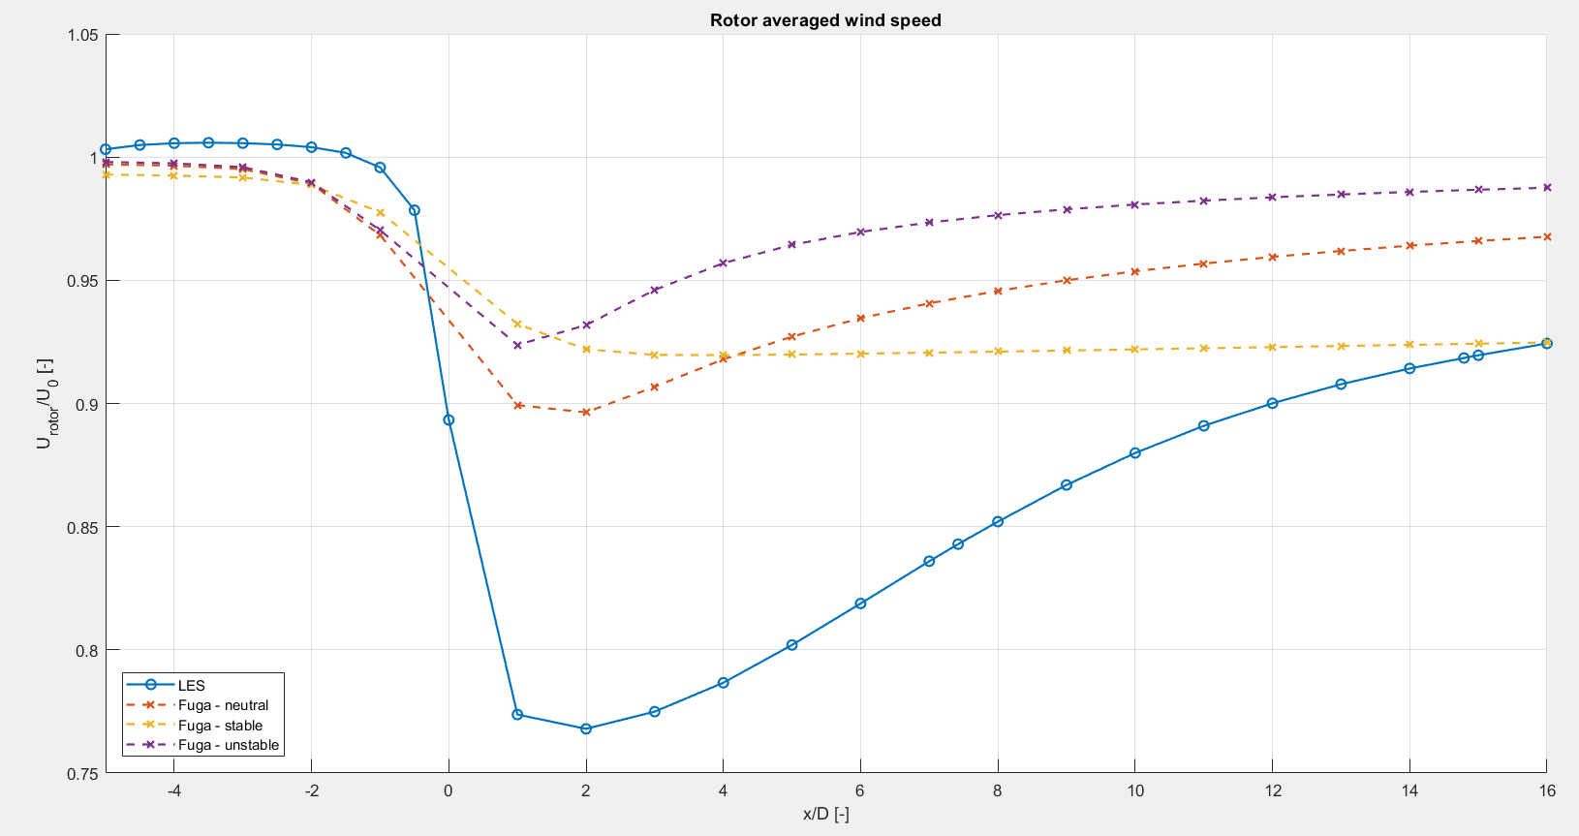
Single wind turbine

Slide 7
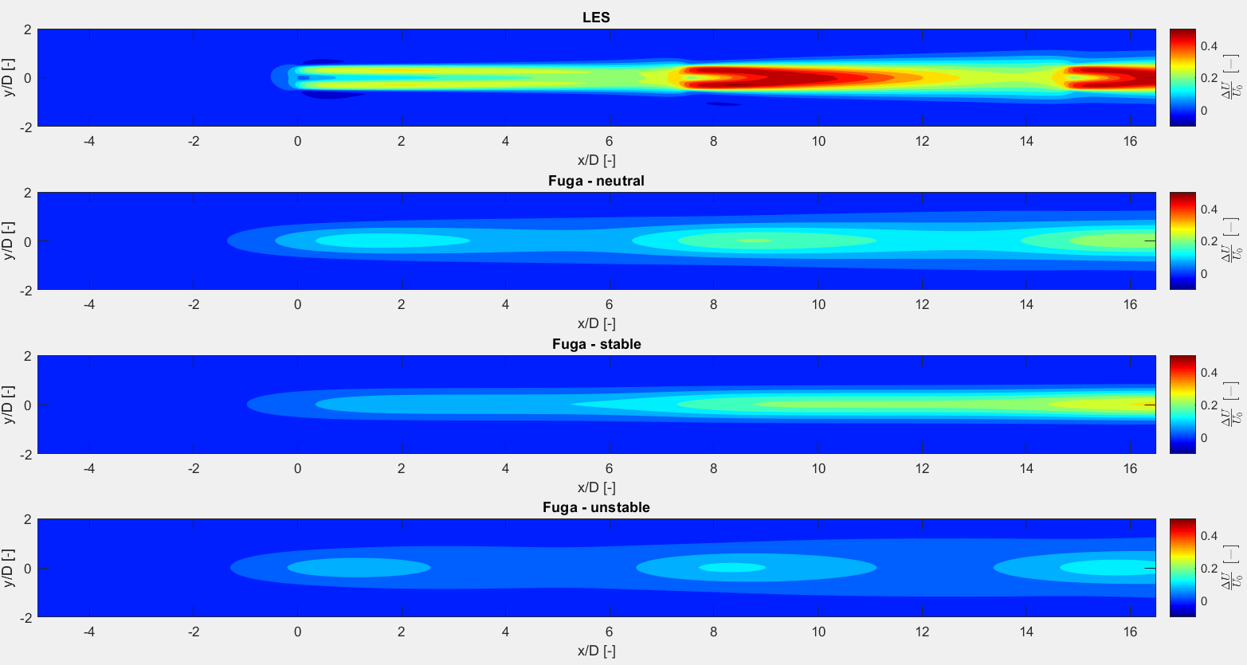
Three wind turbines

Slide 8
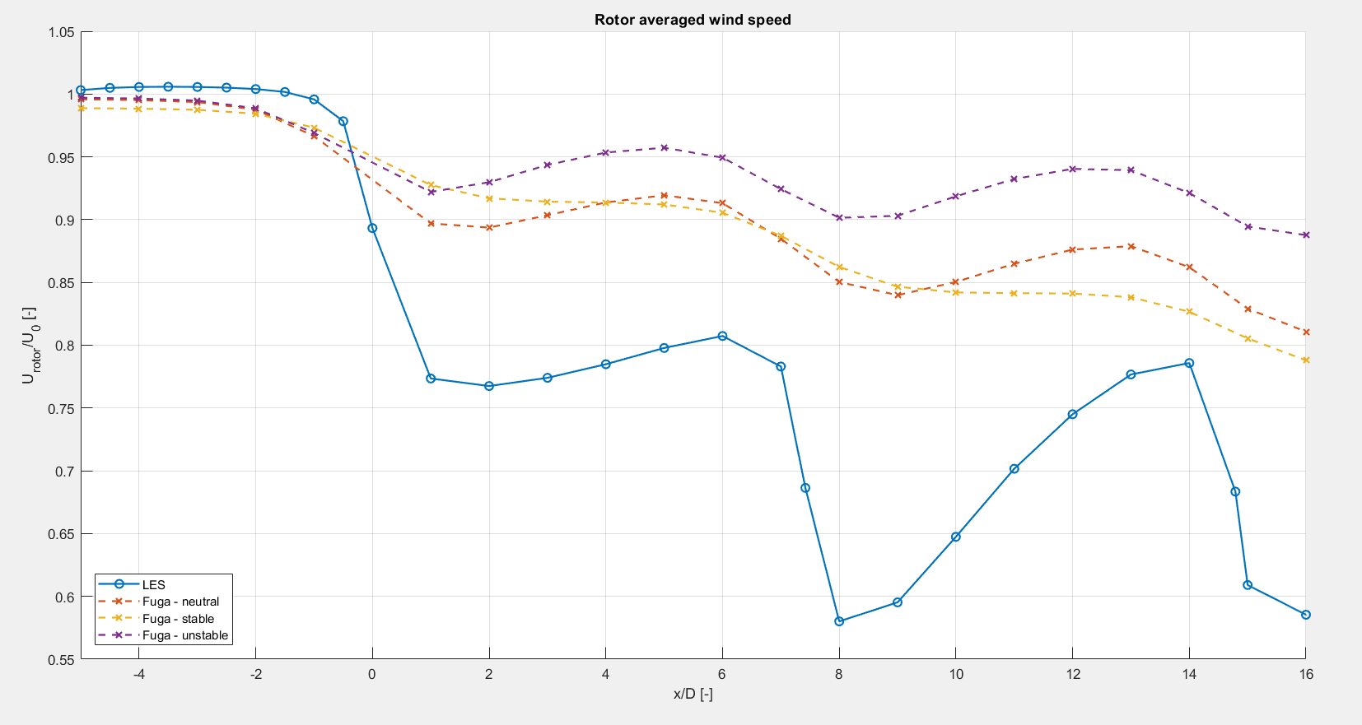
Three wind turbines

